Slide 1
Extra Slides

Slide 2
Unparsing: dfdl:outputValueCalc
Property - defines an evaluation at unparse time that provides the value of an element before it is written out.
Expressions can refer to parts of the Infoset that are after it.

Slide 3
Things DFDL (v1.0 + BLOB) Does
DFDL is for Images and Video
Originally not in scope
Large user demand to use DFDL on the metadata content of image file formats
Cybersecurity applications
Adding BLOB (Binary Large Object) feature to DFDL language to enable DFDL to describe image files

Slide 4
Daffodil Future Development
Cross-validation/test with IBM DFDL
Interop test on all IBM-created DFDL schemas
Tutorials on writing/debugging DFDL schemas
Improved trace and debug
Full SAX-style streaming behavior for parsing, unparsing
Faster schema compilation for large schemas
Integrate into more frameworks
Extensions: recursion, BLOB/CLOB, table-lookup,...

Slide 5
Interoperability – Daffodil & IBM
Interoperable
Daffodil
IBM DFDL
MIL-STD-2045
PCAP
VMF
Link16
NACHA
USMTF CSV
IBM4690-TLOG
ISO8583
EDIFACT
vCard
Improve Daffodil
A-GNOSC REMEDY
ARMY DRRS
USCG UCOP
CEF-R1965
modify
schemas
SWIFT-MT (IBM)
HIPAA-5010 (IBM)
HL7-2.7 (IBM)
Not tried yet. These schemas may work or require small changes to work on IBM DFDL.
EDI and FINSERVE formats known to require additional DFDL features in Daffodil.
Schemas available under license from IBM; need permission to test.

Slide 6
What I said I would talk about….
DFDL - what it is,
the standard,
why it is important,
what it does (and doesn't) do for systems that intake/export data,
and how it is different from other approaches to this problem in the past.
All of this motivates why we're incubating Daffodil.
The talk also covers technical status of Daffodil code base to give prospective contributors a bit of insight into what the code-base/effort is like.

Slide 7
Things DFDL (v1.0) Doesn't Do
That's not stopping anybody!
DFDL is used for....
Scraping data from MS-Word ".doc" files
Extract metadata of interest from files and skip over the rest
Image file formats (memory size limitations)
Parse spreadsheets that are not CSV-like

Slide 8

DFDL not a Transformation Language
What you want
is this data....
What you have....
Maybe I can do this with DFDL/Daffodil
<x>6.847</x>
<y>abc</y>
011010010110100101010001010100101010010101001101111
?
I'll just annotate this schema for the data I want...
Described by this
schema
XML schema
Notes:
Let's say you....
Want certain data in a particular logical structure
So you find a suitable XML Schema or create one
Then you start adding DFDL annotations to that, so as to read the native data format, and populate your logical structure
Then you..... can't get it to work
Why?

Slide 9
DFDL not a Transformation Language
What you want
is this data....
What you have....
Maybe I can do this with DFDL/Daffodil
<x>6.847</x>
<y>abc</y>
011010010110100101010001010100101010010101001101111
!!!
I'll just annotate this schema I found.
Described by this
schema
XML schema
Notes:
This doesn't often work out because you are starting from an XML Schema that isn't designed to match the shape of the input data.
It also may have XML Schema constructs in it that aren't allowed in DFDL's subset of XML schema.

Slide 10



DFDL not a Transformation Language
Describe the original file format
Describe how to transform that into what you want
01101001011010010101000101010010101001
DFDL
<a>42</a>
Xform
<x>6.847</x>
<y>abc</y>
Described by this
schema
DFDL schema must match shape of this data
These schemas are usually quite different
XML schema for shape of my desired target data
Notes:
You actually have two problems here
Describe the original file format
Describe how to transform that into what you want
DFDL is only about the original format
The logical "shape" of the DFDL schema must match the physical layout of the data.
Typically does not match "what you wanted" if you have a pre-defined schema in mind
That said....
DFDL can do some simple transformations
Rich transformations need something else
XSLT, XQuery, a data-integration tool, etc.
If the system you are bringing data into is itself already a transformation system,.... then this is not a problem.
ETL - Extract, Transform, Load vs.
ELT - Extract, Load, then Transform

Slide 11
DFDL v1.0 is pretty much done
Closed to new features
Any new features are very restricted at this point
Only Errata/Corrections and clarifications
Maybe...
a few feature things associated with computed elements
We're accumulating new feature requests toward DFDL version v2.0 now.

Slide 12
DFDL v2.0 - Wishlist
Lifting the v1.0 limitations
Recursion
Offsets
Layering (implemented already in Daffodil)
BLOBs (Binary large objects)
for image/video files
Numeric-to-symbolic conversion

Slide 13
How to get a Feature into DFDL
Propose new DFDL language feature to DFDL Workgroup
Email to dfdl-wg@ogf.org
Get feedback and refine proposal
Implement in Daffodil
Get experience with new feature
Refine/improve
Create "Experience Document" explaining it
Formally propose feature for inclusion in DFDL (v2.0)
Email to dfdl-wg@ogf.org

Slide 14
Cool Daffodil Ideas...
Hybrid Infoset
Daffodil directly constructs your native data representation
Remove the XML/JSON overheads
Ultra-fast backend for Daffodil
Generate C/C++
Generate FPGA for wire-speed parse/unparse
These kinds of things only make sense with a standards-based open source system like Daffodil.

Slide 15
ASN.1

Slide 16
Why is DFDL Needed? - ASN.1 ECN
What about ASN.1 Encoding Control Notation?
Already an ISO Standard (since 2008)
Conceptually similar
Logical schema language + notations for physical representation
Very different in the details.
Developers [ Love | Hate ] [ ASN.1 | XML ]
Differences that matter:
ASN.1 ECN
No open source implementation (as of 2018-08-29)
Extension of a binary data standard ASN.1 BER/PER/DER
Goal to describe legacy protocol messages
DFDL
Open source Daffodil implementation
Extension of a textual data standard XML
Goal to be union of data integration tool capabilities for format description

Slide 17
Why is DFDL Needed?
But what about...
Apache Avro
Apache Thrift
Google GPBs
ASN.1 BER (or PER/DER/XER)
Those great, but are prescriptive.
They don't describe formats, they are data formats themselves.
We need a descriptive language.

Slide 18
Why is DFDL Needed?
But what about...
ASN.1 ECN (Encoding Control Notation)
Good point....
When we started on DFDL, ASN.1 ECN didn't exist yet as a standard. ASN.1 was prescriptive so, not relevant.
Sources of inspiration for DFDL were existing commercial data integration products. ASN.1 was telco-message centric.
DFDL had to be similar to these existing products to be acceptable.
Once we found out about it, it seemed too complex.
In the long run this may be naive. DFDL is also complex, as is XML Schema.
We wanted XML's tangibility (i.e., text) for logical data.
We were already started down the XML schema path, which was already known to be a preferred approach in the marketplace.
Internet standards from W3C such as XML and XML schema were hot then, ITU stuff, not so much....

Slide 19
DFDL and ASN.1 ECN
DFDL
Grammar: XML schema (subset)
Format descriptions: DFDL annotations
Test/Tangibility - XML text
Standard: Open Grid Forum (OGF) Proposed Recommendation since 2014
OGF is a small, little known organization
Commercial - IBM, European Space Agency
Open source - Apache Daffodil (Incubating)
ASN.1 Encoding Control Notation (ECN)
Grammar: ASN.1
Format Descriptions: Encoding Control Notation
Test/Tangibility - ASN.1 Basic Encoding Rules (binary - tools needed to see it)
Standard: ITU then ISO Standard since 2008 - ISO/IEC 8825-3
ITU organization is big. Many contributors.
Commercial - OSS Nokalva
Open source - ??? (none for ECN as of my last search 2018-08-29)

Slide 20
Why is DFDL Needed?
Many other libraries are available
Ex: https://github.com/dloss/binary-parsing
Lists 21 different "binary" tools
interestingly.... omitting ASN.1 ECN
Only two are standards-based
DFDL - Open Grid Forum (OGF)
ASN.1 Encoding Control Notation - ISO/IEC 8825-3
Of those, only one has an open source implementation
DFDL - Daffodil

Slide 21
END

Slide 22
Daffodil Roadmap
2.1.0 - Current version as of May 2018
Roadmap is maintained on project wiki
https://cwiki.apache.org/confluence/display/DAFFODIL/Apache+Daffodil
2.2.0 - Two new important features
Layer support - enables line folding, base64, compress, ...
Message streaming API - enables unbounded streams of messages
2.3.0 - Interoperability
Features to enable Daffodil to run more IBM-published DFDL schemas
Cross-validation test system
BLOB support - enables large image file formats
2.4.0 - Usability, Community Growth
Debug/Trace improvements
Schema compilation speed/space improvements
Developer documentation of Daffodil's internals.
SAX-style event streaming - large documents/files (non-BLOB)
Tutorials on DFDL
... and your needed features here!

Slide 23
Daffodil Performance
Varies with complexity of data format
Single-thread timings, as of 2017-09-01, Daffodil 2.0.0 release
format | parse rate (MB/sec) | unparse rate (MB/sec)
CSV - simple delimited text | 1.2 | 2.8
Link16 J3.5 - dense binary | 0.8 * | 0.2
PCAP - Binary IP Packets | 20 | 2.2
ATO - complex delimited text | 0.3 | 0.9
* = Approximately 20K Link16 NACT messages/sec with 3 link16 words each. (~60 bytes/msg)

Slide 24
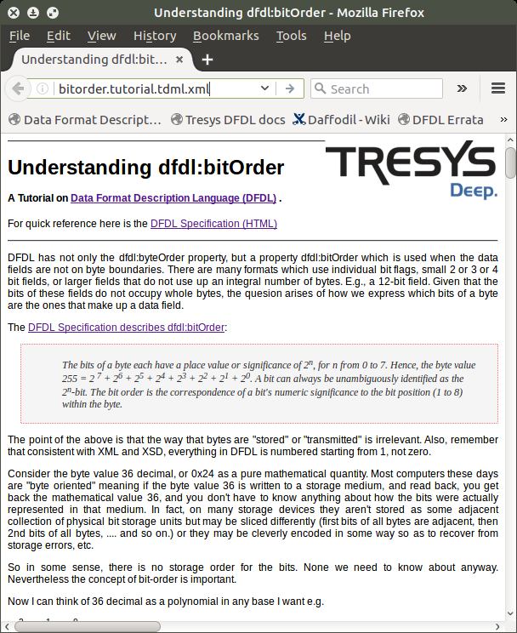
HTML page rendered from “.tdml.xml” file directly by Firefox using XSLT and CSS

Slide 25
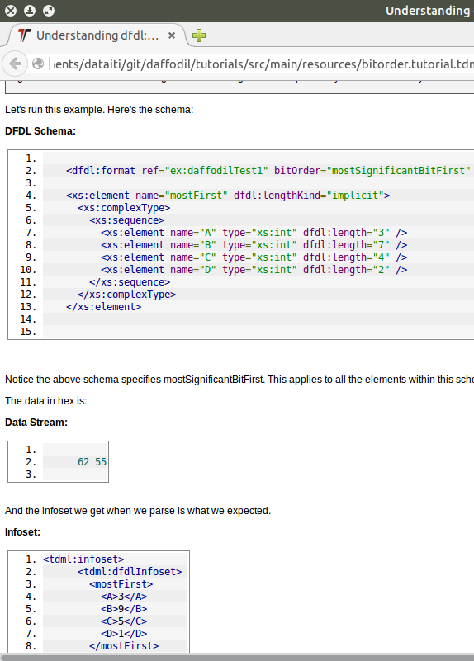
TDML test parts are also rendered

Slide 26
Daffodil Unparser dfdl:outputValueCalc
DFDL and Daffodil have powerful computation capabilities not seen in other prior format description systems.
Unparser can compute element values to store earlier in the data, based on infoset elements that are later.
Infoset events are received, infoset tree is built incrementally.
outputValueCalc element nodes are added to tree.
Producer "Co-routine" (really just an object) for expression evaluation is queued on nodes waiting for values or children.
Data output streams start direct, split off a buffering part, then are collapsed back.

