Slide 1


Data Format Description Language (DFDL)
& the
Apache DaffodilTM Project
DFDL is ISO/IEC 23415
For Daffodil Version 4.0.0
2025-11-11-11-11
DFDL is OGF GFD.240
Apache Daffodil is a Trademark of the Apache Software Foundation

Slide 2
Agenda
Motivation: Why is DFDL Needed?
Introduction to DFDL
  Use Cases for DFDL
Examples
  CSV, PCAP, MIL-STD-2045
DFDL Schemas
Apache Daffodil Status
Example
  Daffodil Java API Use

Slide 3
Motivation
Why is DFDL needed?

Slide 4
Why ISO/OGF DFDL?
There are hundreds of ad-hoc data format description systems
Every Enterprise Software Company
Every kind of software that takes in data:
IBM (10+)
Oracle(10+)
SAP(10+)
Microsoft
SAS
SyncSort
AbInitio
Pervasive
Qlik/Expressor
.... Dozens more
data directed routing
database
data analysis and/or data mining
data cleansing
master data management
application integration
data visualization
…
All these data format descriptions are:
proprietary
ad-hoc
incompatible
Even within products of the same company!
Notes:
To be fair, there have been a number of libraries that

Slide 5
Why DFDL is Needed
Avoid customer lock in by vendors
Provide skills leverage
  DFDL is an ISO standard
  DFDL has an Open-Source implementation

Slide 6
Why is DFDL Needed?
But what about...
  Apache Avro
  Apache Thrift
  Google Protocol Buffers
  ASN.1 BER (or PER/DER/XER)
Those are great but are prescriptive.
  They don't describe formats; they are data formats
We need a descriptive language.

Slide 7
Why is DFDL Needed? - ASN.1 ECN
What about ASN.1 Encoding Control Notation?
Doesn't it do what DFDL Does?
ASN.1 ECN is Conceptually Similar
  Logical schema language
  Separate file of ECN notations for physical representation
  Also ISO Standard (since 2008)
ASN.1 ECN has Very Different Capabilities
  Does not support textual data formats
  No current open-source implementation of ECN (as of 2025)
Want a side-by-side comparison?
  See the DFDLSchemas FakeTDL DFDL Schema project

Slide 8
Solving the Data Format Problem
Three things are required:
Open Standard DFDL
  Long-term sponsors
    IBM – has commercial DFDL implementations
    US DoD, Canada DND
  ISO/IEC and OGF Standard
DFDL schemas for important data formats
A High-Quality Open-Source Library Implementation
  With a supporting community of developers
  With available commercial support

Slide 9
INTRODUCTION TO DFDL

Slide 10
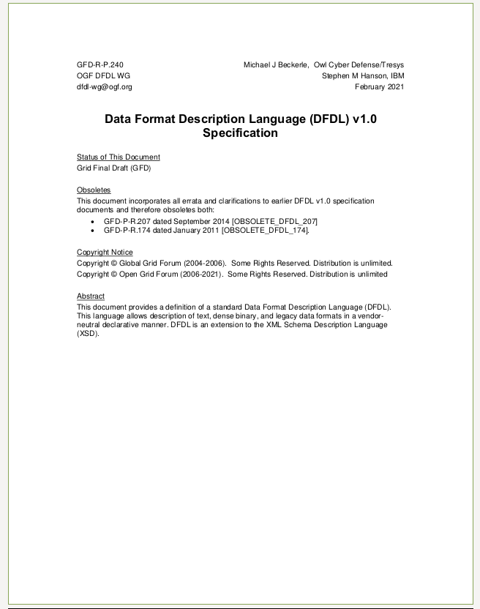
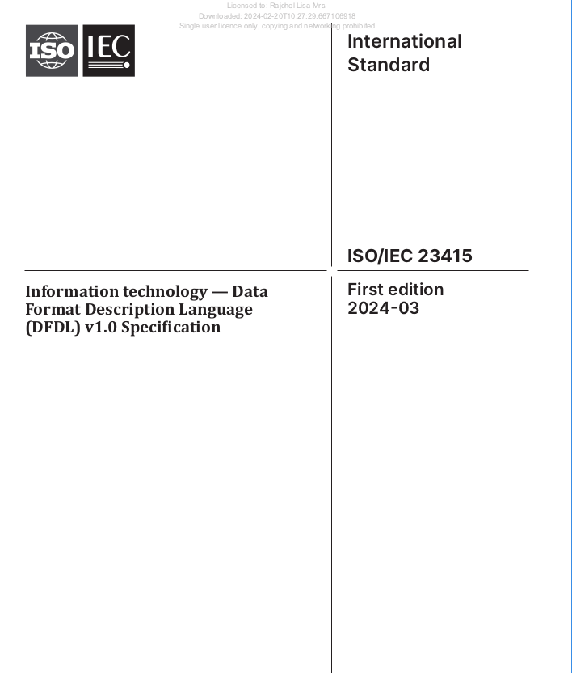
DFDL is ISO/IEC 23415:2024
ISO Publicly Available Standard (PAS)
  PAS - Pairs a small standards org with ISO
  Lots of small standard orgs do this: OGF, W3C, DMTF, OMG, ...
You can still get it free
  from Open Grid Forum (OGF) as GFD.240
Future OGF versions will become ISO PAS
Notes:
10
10
UNCLASSIFIED/FOR OFFICIAL USE ONLY
<footer>

Slide 11
Data Format Description Language
DFDL is a way of describing data formats
It is NOT a data format itself!
DFDL combines State-of-the-Art
Union of capabilities across many marketplace data integration products/tools/packages
DFDL adds small number of real innovations
Overcome limitations of prior-gen e.g.,
  Computed Elements Capability - Unparse as well as Parse!
  Expression language
  BitOrder
Notes:
11
UNCLASSIFIED/FOR OFFICIAL USE ONLY

Slide 12
Data Format Description Language
Core Concepts
  Leverage XML Schema (XSDL)
    Used as the Grammar scaffolding
    Describes the logical data model
    DFDL uses only a subset of XML schema
    XSDL provides standard ways to annotate schemas. DFDL uses this.
  Add DFDL annotations
    Describe the physical representation.
  Read and write from same DFDL Schema
Because Developers [ Love | Hate ] XML
  The DFDL Schema is based on XSDL
  But ... the Infoset created when parsing data
    Can be XML
    Can be JSON
    Via API - can directly populate ex: Apache Drill Rows, Apache NiFi Records
Notes:
12
Using XSD was already an idea well-tested and accepted in the marketplace.
Some consider XSD to be very complicated. Hence, DFDL uses only a subset of XSD. The idea was to take from XSD only what we needed, not figure out how everything in XSD would work in DFDL.
Many basic language problems, e.g., namespaces for large schemas, already well handled in XSD. Get those for free. Avoid re-inventing the wheel.
UNCLASSIFIED/FOR OFFICIAL USE ONLY

Slide 13
Example – Delimited Text Data
rlimit=5;rpngx=-7.1E8

Slide 14
Example – Delimited Text Data
Initiator
Separator
Initiator
rlimit=5;rpngx=-7.1E8
ASCII text integer
ASCII text floating point
Separators, initiators (aka tags), & terminators are all examples in DFDL of delimiters

Slide 15
DFDL Schema - Logical
<xs:complexType name=“rPair">
<xs:sequence>
<xs:element name=“rlim" type="xs:int"/>
<xs:element name=“rpng" type="xs:float"/>
</xs:sequence>
</xs:complexType>
Logical
Elements

Slide 16
DFDL schema - Physical
Top level format declaration block applies to this entire schema file.
<xs:annotation>
<xs:appinfo source="http://www.ogf.org/dfdl/">
<dfdl:format representation="text"
textNumberRep="standard" encoding="ascii"
lengthKind="delimited“ .../>
</xs:appinfo>
</xs:annotation>
<xs:complexType name=“rPair">
<xs:sequence dfdl:separator=";" ... >
<xs:element name="rLim" type="xs:int"
dfdl:initiator=“rLimit=" ... />
<xs:element name=“rpng" type="xs:float"
dfdl:initiator=“rpngx=" ... />
</xs:sequence>
</xs:complexType>
DFDL properties
;
_{rLimit=5}
_{rpngx=-7.1E8}

Slide 17
DFDL schema is also an XML Schema
Type
reference
<xs:complexType name=“rPair">
<xs:sequence dfdl:separator=";" ... >
<xs:element name="rLim" type="lt100"
dfdl:initiator=“rLimit=" ... />
<xs:element name=“rpng" type="xs:float"
dfdl:initiator=“rpngx=" ... />
</xs:sequence>
</xs:complexType>
<simpleType name="lt100">
<restriction base="xs:int">
<maxInclusive value="100"/>
</restriction>
</simpleType>
XML Schema facet constraints are also part of the DFDL schema
A good DFDL schema has both the DFDL properties AND the XSD facet constraints.

Slide 18
DFDL Data and Infoset Lifecycle
Data
rLimit=5;rpngx=-7.1E8
Parse
Unparse
DFDL Schema
DFDL Implementation
DFDL Implementation
Element
Name: rValues
Infoset
XML
or
JSON
or
other
Element
Name: rLimit
Value: 5
Type: Int
Element
Name: rpngx
Value: -7.1E8
Type: Double
Notes:
You don't have to parse first in order to unparse. You can start at the bottom with an infoset, and directly unparse it.

Slide 19
DFDL Use Cases
Deep Content Inspection/Sanitization
  Cross Domain Solutions, Network Guards
  Data Filtering
  Rip-and-Rebuild Firewalls
Data-Directed Routing
Data Intake
  Data Warehouse or Analytical Data Store
Interoperability / Data Translation
Conversion of Legacy Data to Modern Formats
Open Data / Data Export
  Recasting data as XML or JSON for export/publishing

Slide 20
Q: What Kinds of Data is DFDL Good For?
A: Not everything
Data = Anything
Documents: PDF, MS-Office
Images, Video, Audio
Link16, VMF, USMTF, OTH-Gold, JANAP-128
Software, Patches/Updates
Commercial: X25, HL7, NACHA, ISO8583
Archive files: Zip, Tar
Transaction records
Rows, CSV-like
Nested, Hierarchical
Images*
Databases
HDF4/5
Postgres
NGA datasets: DAFIF, VVOD
Weather/Satellite
XML/EXI
JSON
* metadata, not pixels

Slide 21

Q: What Kinds of Data is DFDL Good For?
A: Not everything
Data = Anything
Documents: PDF, MS-Office
Data = DFDL Described
Images, Video, Audio
Link16, VMF, USMTF, OTH-Gold, JANAP-128
Software, Patches/Updates
Commercial: X25, HL7, NACHA, ISO8583
Archive files: Zip, Tar
Transaction records
Rows, CSV-like
Nested, Hierarchical
Images*
Databases
HDF4/5
Postgres
NGA datasets: DAFIF, VVOD
Weather/Satellite
XML/EXI
JSON
* metadata, not pixels

Slide 22
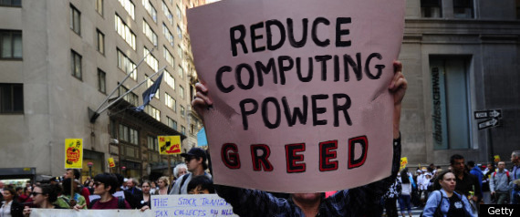
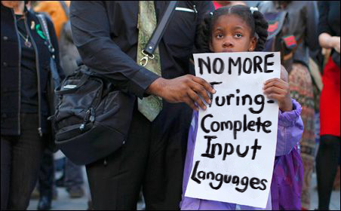
Current DFDL v1.0 Language Limitations
Recursive types
  DFDL v1.0 not a Turing-Complete language
  On purpose - it's a feature, not a bug
Position of elements "by offset"
  Random jumping around data
  Ex: TIFF file format
    TIFF cannot be described in DFDL v1.0
Thanks to
http://langsec.org/occupy/

Slide 23
Things DFDL (v1.0) Doesn't Do
DFDL v1.0 was not originally intended for:
  Document file formats
    e.g., MS Office documents (.doc), or RTF, PDF
  Images, Video, Audio
  Archives like zip files or tar files
  Core dump/memory image format
  Storage format of a RDBMS table
  Graphs of pointers - object graphs dumped from memory
DFDL is being extended to cover more
  BLOBs - for images, video, audio
    Already available in Daffodil from v2.5.0

Slide 24
Examples
CSV (ASCII text delimited)
PCAP (variable length binary)
MIL-STD-2045 (dense bit-packed binary, LSBF)

Slide 25
Example: CSV
Comma-Separated Values

Slide 26
Example - CSV
Textual Format (ASCII)
Comma-Separated Values
Tabular data
Rows separated by newlines
Fields separated by commas
Smith,Charles,36,6.2
Williams,Mary,51,5.5

Slide 27
Example - CSV
<schema>
<annotation>
<appinfo source="http://www.ogf.org/dfdl/">
<dfdl:format ref="defaults"
representation="text"
encoding="ASCII"
lengthKind="delimited"
escapeSchemRef="quoted"
occursCountKind="parsed" />
<dfdl:defineEscapeScheme name="quoted">
<dfdl:escapeScheme escapeKind="escapeBlock"
escapeBlockStart="&quot;"
escapeBlockEnd="&quot;"
escapeEscapeCharacter="&quot;">
</dfdl:defineEscapeScheme>
</appinfo>
<annotation>
<schema>

Slide 28
Example - CSV
<schema>
<annotation>
<appinfo source="http://www.ogf.org/dfdl/">
<dfdl:format ref="defaults"
representation="text"
encoding="ASCII"
lengthKind="delimited"
escapeSchemRef="quoted"
occursCountKind="parsed" />
<dfdl:defineEscapeScheme name="quoted">
<dfdl:escapeScheme escapeKind="escapeBlock"
escapeBlockStart="&quot;"
escapeBlockEnd="&quot;"
escapeEscapeCharacter="&quot;">
</dfdl:defineEscapeScheme>
</appinfo>
<annotation>
<schema>

Slide 29
Example - CSV
<element name="csv">
<complexType>
<sequence dfdl:separator="%NL;"
dfdl:separatorPosition="postfix">
<element name="record" maxOccurs="unbounded">
<complexType>
<sequence dfdl:separator=","
dfdl:separatorPosition="infix">
<element name="item" type="xs:string"
maxOccurs="unbounded"/>
</sequence>
</complexType>
</element>
</sequence>
</complexType>
</element>

Slide 30
Example - CSV
<element name="csv">
<complexType>
<sequence dfdl:separator="%NL;"
dfdl:separatorPosition="postfix">
<element name="record" maxOccurs="unbounded">
<complexType>
<sequence dfdl:separator=","
dfdl:separatorPosition="infix">
<element name="item" type="xs:string"
maxOccurs="unbounded"/>
</sequence>
</complexType>
</element>
</sequence>
</complexType>
</element>

Slide 31
Example - CSV
CSV Input
csv
record
record
item Smith
item Charles
item 36
item 6.2
item Williams
item Mary
Item 51
item 5.5
DFDL Infoset
Smith,Charles,36,6.2
Williams,Mary,51,5.5
DFDL Implementation
CSV DFDL Schema

Slide 32
Example: PCAP
Packet Capture File Format

Slide 33
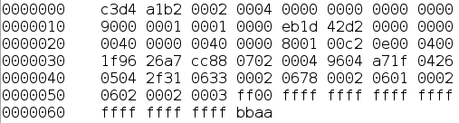
Example - PCAP
PCAP Data
pcap
global header
packet
field
field
field
header
data
DFDL Infoset
DFDL Implementation
PCAP DFDL Schema

Slide 34
Example - PCAP
Network Packet Capture
Binary Format
Global Header
Packet Header/Data
Variable Endianness and Data Length
Global Header
Packet Header
Packet
Data
Packet Header
Packet
Data
…

Slide 35
Example - PCAP
<schema>
<annotation>
<appinfo source="http://www.ogf.org/dfdl/">
<dfdl:format ref="defaults"
representation="binary"
alignment="8"
alignmentUnits="bits"
lengthUnits="bits"
binaryNumberRep="binary"
lengthKind="implicit"
byteOrder="{ $byte_order }" />
<dfdl:defineVariable name="byte_order" type="xs:string"/>
</appinfo>
</annotation>
<simpleType name="uint32" dfdl:lengthKind="explicit"
dfdl:length="32">
<restriction base="xs:unsignedInt"/>
</simpleType>
</schema>

Slide 36
Example - PCAP
<schema>
<annotation>
<appinfo source="http://www.ogf.org/dfdl/">
<dfdl:format ref="defaults"
representation="binary"
alignment="8"
alignmentUnits="bits"
lengthUnits="bits"
binaryNumberRep="binary"
lengthKind="implicit"
byteOrder="{ $byte_order }" />
<dfdl:defineVariable name="byte_order" type="xs:string"/>
</appinfo>
</annotation>
<simpleType name="uint32" dfdl:lengthKind="explicit"
dfdl:length="32">
<restriction base="xs:unsignedInt"/>
</simpleType>
</schema>

Slide 37
Example - PCAP
<schema>
<annotation>
<appinfo source="http://www.ogf.org/dfdl/">
<dfdl:format ref="defaults"
representation="binary"
alignment="8"
alignmentUnits="bits"
lengthUnits="bits"
binaryNumberRep="binary"
lengthKind="implicit"
byteOrder="{ $byte_order }" />
<dfdl:defineVariable name="byte_order" type="xs:string"/>
</appinfo>
</annotation>
<simpleType name="uint32" dfdl:lengthKind="explicit"
dfdl:length="32">
<restriction base="xs:unsignedInt"/>
</simpleType>
</schema>

Slide 38
Example - PCAP
<element name="magic_number" type="ex:uint32"
dfdl:byteOrder="bigEndian">
<annotation>
<appinfo source="http://www.ogf.org/dfdl/">
<dfdl:setVariable ref="byte_order"><![CDATA[{
if (. eq dfdl:unsignedInt('xA1B2C3D4')) then 'bigEndian'
else if (. eq dfdl:unsignedInt('xD4C3B2A1') then 'littleEndian'
else daf:error() }]]>
</dfdl:setVariable>
<dfdl:property name="outputValueCalc"><![CDATA[{
if ($dfdl:byteOrder eq 'bigEndian')
then dfdl:unsignedInt('xA1B2C3D4')
else dfdl:unsignedInt('xD4C3B2A1')
}]]></dfdl:property>
</appinfo>
</annotation>
</element>

Slide 39
Example - PCAP
<element name="magic_number" type="ex:uint32"
dfdl:byteOrder="bigEndian">
<annotation>
<appinfo source="http://www.ogf.org/dfdl/">
<dfdl:setVariable ref="byte_order"><![CDATA[{
if (. eq 2712847316) then 'bigEndian'
else if (. eq 3569595041) then 'littleEndian'
else daf:error() }]]>
</dfdl:setVariable>
<dfdl:property name="outputValueCalc"><![CDATA[{
if ($dfdl:byteOrder eq 'bigEndian')
then dfdl:unsignedInt('xA1B2C3D4')
else dfdl:unsignedInt('xD4C3B2A1')
}]]></dfdl:property>
</appinfo>
</annotation>
</element>

Slide 40
Example - PCAP
<element name="PacketHeader">
<complexType>
<sequence>
<element name="Seconds" type="pcap:uint32"/>
<element name="USeconds" type="pcap:uint32"/>
<element name="InclLen" type="pcap:uint32"
...
/>
<element name="OrigLen" type="pcap:uint32"
...
/>
</sequence>
</complexType>
</element>
...
<element ref="pcap:LinkLayer"
dfdl:lengthUnits="bytes" dfdl:lengthKind="explicit"
dfdl:length="{ ../PacketHeader/InclLen }"/>

Slide 41
Example - PCAP
<element name="PacketHeader">
<complexType>
<sequence>
<element name="Seconds" type="pcap:uint32"/>
<element name="USeconds" type="pcap:uint32"/>
<element name="InclLen" type="pcap:uint32"
...
/>
<element name="OrigLen" type="pcap:uint32"
...
/>
</sequence>
</complexType>
</element>
...
<element ref="pcap:LinkLayer"
dfdl:lengthUnits="bytes" dfdl:lengthKind="explicit"
dfdl:length="{ ../PacketHeader/InclLen }"/>

Slide 42
Example - PCAP
<element name="PacketHeader">
<complexType>
<sequence>
<element name="Seconds" type="pcap:uint32"/>
<element name="USeconds" type="pcap:uint32"/>
<element name="InclLen" type="pcap:uint32"
dfdl:outputValueCalc="{
if (dfdl:valueLength(
../../pcap:LinkLayer/pcap:Ethernet,
'bytes') le 60) then 60
else
dfdl:valueLength(
../../pcap:LinkLayer/pcap:Ethernet,
'bytes') }"
/>
<element name="OrigLen" type="pcap:uint32"
dfdl:outputValueCalc="{ ../InclLen }"/>
</sequence>
</complexType>
</element>
...
<element ref="pcap:LinkLayer"
dfdl:lengthUnits="bytes" dfdl:lengthKind="explicit"
dfdl:length="{ ../PacketHeader/InclLen }"/>

Slide 43
Example - PCAP
PCAP Data
pcap
global header
packet
field
field
field
header
data
DFDL Infoset
DFDL Implementation
PCAP DFDL Schema

Slide 44
Example: MIL-STD-2045
A dense bit-packed binary data format similar to many MIL-STD formats, but publicly available.
Uses Least-Significant-Bit-First bit order – typical of MIL formats, different from most non-MIL formats.

Slide 45
Example - MIL-STD-2045
Densely packed binary with unique bit order
dfdl:representation="binary"
dfdl:alignment="1"
dfdl:alignmentUnits="bits"
dfdl:lengthUnits="bits"
dfdl:lengthKind="explicit"
dfdl:length
dfdl:byteOrder="littleEndian"
dfdl:bitOrder="leastSignificantBitFirst"

Slide 46
Example - MIL-STD-2045
7-bit strings embedded in binary
dfdl:encoding=“X-DFDL-US-ASCII-7BIT-PACKED"
0x7F (DEL) terminated, unless max-length met
<element name="str50" type="xs:string"
dfdl:lengthPattern="[^\x7F]{0,49}(?=\x7F)|.{50}" />
<sequence dfdl:terminator="{
if (fn:string-length(./str50) eq 50)
then '%ES;'
else '%DEL;'
}" />

Slide 47
Example - MIL-STD-2045
Presence indicators
Presence
Indicator
Optional
Field
<dfdl:discriminator test="{ . eq 1 }" />

Slide 48
Example - MIL-STD-2045
Repeat indicators
Repeat Indicator = 1
Data
Repeat Indicator = 1
Data
Repeat Indicator = 0
Data
another one follows
another one follows
last one
dfdl:occursCountKind="implicit"
minOccurs="1"
maxOccurs="unbounded"
<dfdl:discriminator test="{
if (dfdl:occursIndex() eq 1)
then fn:true()
else ../fields[dfdl:occursIndex() – 1]/repeat_indicator eq 1 }" />
<element name="GRI" type="tns:repeatIndicator"
dfdl:outputValueCalc="{
if (dfdl:occursIndex() lt fn:count(..))
then 1 else 0 }" />

Slide 49
More DFDL Properties
dfdl:assert
dfdl:discriminator
dfdl:newVariableInstance
dfdl:setVariable
dfdl:defineEscapeSchema
dfdl:defineVariable
dfdl:ignoreCase
dfdl:encodingErrorPolicy
dfdl:alignment
dfdl:alignmentUnits
dfdl:fillByte
dfdl:leadingSkip
dfdl:trailingSkip
dfdl:emptyValueDelimiterPolicy
dfdl:outputNewLine
dfdl:prefixIncludesPrefixLength
dfdl:prefixLengthType
dfdl:lengthPattern
dfdl:textPadKind
dfdl:textTrimKind
dfdl:textOutputMinLength
dfdl:escapeSchemeRef
dfdl:escapeKind
dfdl:escapeCharacter
dfdl:escapeBlockStart
dfdl:escapeBlockEnd
dfdl:escapeEscapeCharacter
dfdl:extraEscapedCharacters
dfdl:generateEscapeBlock
dfdl:textBidi
dfdl:textStringJustification
dfdl:textStringPadCharacter
dfdl:textNumberJusitification
dfdl:textStandardNaNRep
dfdl:textStandardZeroRep
dfdl:textStandardBase
dfdl:binaryNumberRep
dfdl:binaryPackedSignCodes
dfdl:binaryFloatRep
dfdl:calendarPattern
dfdl:binaryCalendarRep
dfdl:nilValueDelimiterPolicy
dfdl:initiatedContent
dfdl:separatorPosition
dfdl:separatorSuppressionPolicy
dfdl:floating
dfdl:hiddenGroupRef
dfdl:initiatedContent
dfdl:occursCountKind
dfdl:occursStopValue
dfdl:inputValueCalc
dfdl:outputValueCalc

Slide 50
DFDL Schemas
What's available? Where to find them?

Slide 51
DFDL Schemas - Free/Open-Source
Github DFDLSchemas
  many useful learning examples
    fakeTDL
    envelope-payload
    tcpHeader
    PCAP
    ethernetIP
  many real production-use schemas
    MIL-STD-2045 header schema
    syslog
    shape
    NITF
    MagVar
  commercial/business schemas
    Cobol, EDIFACT, ISO8583, NACHA
    iCalendar, vCard
Please publish your public-format DFDL schemas here to share with others
US DoD NCDSMO Intelink (CAC Required)
  FOUO/CUI Schemas
  link16 with JREAP (MIL-STD-6016 F1)
    some older Link16 schemas also
  OILSTOCK
  Demo schemas for other military formats
    GMTIF, VMF, USMTF, ...
Please publish your FOUO/CUI schemas here for DoD shared use.

Slide 52
Support/Help
Apache Daffodil project
  join users@daffodil.apache.org mailing list
  ask questions there - note: public archived list

Slide 53
Learning Resources
github DFDLSchemas examples
OGF DFDL v1.0 Spec (as HTML) (as PDF)
DFDL Schema Style Guide (from Apache Daffodil project)
Tutorials on DFDL by MITRE
IBM
  YouTube videos and numerous articles - search web for "IBM DFDL"
  Getting Started with the Data Format Description Language
Open Grid Forum DFDL Workgroup
  Tutorials 1 - 6: Download from here
Note: AI bots like ChatGPT and Gemini don't know much about DFDL yet. (as of December 2025)

Slide 54
Apache Daffodil™
Status Report

Slide 55
Avoid Version Confusion
DFDL Language Specification
Apache Daffodil™ Software
v1.0.0
v1.1.0
v2.0.0
v2.1.0
...
v2.4.0
...
v3.0.0
....
v4.0.0
....
v1.0
DFDL Schemas have their
own individual release version numbers.
E.g.., mil-std-2045 is release 1.3.3

Slide 56
Daffodil
Open Source
  Apache Daffodil - Announced in March 2021
  Apache = A Permissive/Commercial Friendly License – embed how you wish, into anything.
Runs on Java 8+ Virtual Machine
Started as research project by UofI ~2009
Originally developed by Owl (then Tresys) ~2012
  Funded by the USG
  Became Apache Incubator project in 2017
  Graduated from Apache Incubator in March 2021
Highly interoperable with IBM DFDL (since v2.4.0)
Active development
https://daffodil.apache.org

Slide 57
Daffodil - Recent Major Features
EXI support
Pluggable Character Sets
Embedded XML Strings in data
C-Code generator backend
Pluggable 'layers' for Checksums, line-folding, CRC, etc.
Schematron Support - pluggable Validators
SAX API

Slide 58
Daffodil VSCode Extension
Data Format Development and Debug IDE
  Set data breakpoints
  Step through parsing
  Save TDML test cases
  Edit large data files
Extension to VSCode IDE
  Front-end - Typescript
  Back-end server - Scala

Slide 59
Daffodil
If you download it, what do you get?
Jar libraries – runs on JVM
  Compiler, utilities, TDML runner
  Signed Jars available from Maven Central
  Runtime 1 - Scala - runs on JVM - supports nearly all of DFDL v1.0
  Runtime 2 - C-generator - creates fast C code - Small subset of the DFDL language
Command Line Interface
  Interactive CLI debugger and trace
Java & Scala API with documentation
XML and JSON for parse-output, unparse-input
You must get your DFDL schemas somewhere...
  github (DFDLSchemas, others)
  Write them! (and share them!)
Notes:
59
UNCLASSIFIED/FOR OFFICIAL USE ONLY

Slide 60
Daffodil Internal Components
Compiler
  compiles DFDL schemas to runtime data structures
  Issues diagnostics
Scala API
Command Line Interpreter
Java API
TDML Runner
Test (& Tutorial) Data Markup Language
Runtime2
(C-code Gen)
Runtime 1
DPath - Xpath-like language
compiler
runtime
Parser primitives
Code Generator
Tests - Unit
(Scala)
Infoset
Convert to/from XML, JSON
Fast, constant-time access
Unparser primitives
Primitives
(C)
Tests - System
(TDML)
Breakpoint debugger
Utility Libraries
for compiler
for runtime
I/O library
bits (not bytes), bitOrder
streaming
non-8-bit-characters (7, 6, 5)
unbounded lookahead - parsing/backtracking, and unparsing
Written in Scala
Notes:
60
UNCLASSIFIED/FOR OFFICIAL USE ONLY

Slide 61
Daffodil Integrations
EXI - binary form of XML - much faster/denser
XProc - Calabash
Apache Spark
Apache NiFi
Apache Drill
SoftwareAGTM Integration Server (aka WebMethodsTM)
Owl CDS products/services
Other companies also!
Potential
  Apache Tika
  Other data-handling frameworks - Flink, Hadoop,....

Slide 62
EXI (binary XML) - Data Size
EXI is a w3c standard for a binary XML
  Same Infoset, same API (SAX)
Requires massively less space than textual XML
See examples on github.com OpenDFDL

Slide 63
Daffodil Code Base
Data as of 2023-03-15 master branch
Main Daffodil library - does not include VSCode Extension
Excludes DFDL Schemas
(Link16 DFDL Schema is 800K+ LoC just by itself)

Slide 64
Daffodil Performance
K03.2
messages
K03.2
messages
Daffodil
Parse & Validate
XML text pipe
Daffodil
Unparse
Uses Daffodil Message Streaming API
The K03.2 message (from MIL-STD-6017) is 49 bytes. Expands to 4555 bytes of XML
  Note: EXI eliminates this text expansion - see earlier slide on EXI.
  This test was done using textual XML
The file was 131072 repeats of that 49 byte message
Intel Core i7-6820HQ CPU @ 2.70 Ghz (a laptop)
Running on 2 processes (parse, unparse), 1 thread each.
81.218 seconds => ~ 0.6 milliseconds per message
Conclusion:
  DFDL/Daffodil is not going to kill your 10msec latency budget.
  Cost will be from additional XML filtering/validation operations

Slide 65
Daffodil Roadmap
Roadmap on https://s.apache.org/daffodil-wiki
Depends on community needs, available developers

Slide 66
Daffodil Community
Scala programmers wanted !
Java programmers who want to learn Scala wanted!
Typescript/Javascript programmers who want to work on the Daffodil VSCode Extension - wanted!

Slide 67
Other DFDL Implementations
IBM DFDL - The First DFDL Implementation - v1.0 Nov 2011
  Embeddable as Library, C and Java
  Includes Eclipse based tooling - graphical DFDL schema editor/test environment
  Found in IBM products:
    IBM App Connect Enterprise product family
    IBM Integration Bus
    IBM InfoSphere Master Data Management
    IBM z/TPF product family
European Space Agency - DFDL4S = DFDL for Space
  Embeddable as Library, Java and C++ versions.
  Binary-data-only subset of DFDL
  Created by ESA for satellite data descriptions
  Evolving to be a fully compatible DFDL subset.
  More info at
    http://eop-cfi.esa.int/index.php/applications/dfdl4s

Slide 68
Interoperability – Apache Daffodil & IBM
Daffodil
Interoperable
IBM DFDL
MIL-STD-2045
NACHA
ISO8583
CSV
QuasiXML
Geonames
IBM4690-TLOG
EDIFACT
vCard
HL7-v2.7
MagVar
USMTF
ARMY DRRS
USCG UCOP
CEF-R1965
IPFIX
VMF
GMTIF
Link16
PCAP SHP
GIF BMP PNG
JPEG NITF
A-GNOSC REMEDY
iCalendar
These use optional DFDL features not supported (yet) by IBM DFDL

Slide 69
Example: Java API
Hello world!
<helloWorld>
<word>Hello</word>
<word>world!</word>
</helloWorld>
Yes, it is 'Hello world!'
This example available on github.

Slide 70
Daffodil Java API – Hello World
public class HelloWorld {
public static void main(String[] args) throws IOException {
... // let's fill this in
}
}
<!– helloWorld.dfdl.xsd -->
…
<dfdl:format ref="daffodilTest1
representation="text" encoding="utf-8"
lengthKind="delimited"/>
…
<element name="helloWorld">
<complexType><sequence>
<element name="word" type="xs:string"
maxOccurs="unbounded"
dfdl:lengthKind="delimited"
dfdl:terminator="%WSP+;"
dfdl:occursCountKind="parsed"/>
</sequence></complexType>
</element>

Slide 71
Daffodil Java API – Hello World
//
// First compile the DFDL Schema
// Creates a Daffodil ProcessorFactory object
//
Compiler c = Daffodil.compiler();
c.setValidateDFDLSchemas(true);
File schemaFile = new File("helloWorld.dfdl.xsd");
ProcessorFactory pf = c.compileFile(schemaFile);
// list any compile-time diagnostics - warnings and errors
List<Diagnostic> diags = pf.getDiagnostics();
for (Diagnostic d : diags) {
System.err.println(d.getSomeMessage());
}
if (pf.isError()) { System.exit(1); }

Slide 72
Daffodil Java API – Hello World
//
// Use ProcessorFactory to create data processors
// As many as you want. They can be run (to parse/unparse) on
// different threads.
//
DataProcessor dp = pf.onPath("/");
ReadableByteChannel rbc =
Channels.newChannel(new FileInputStream("helloWorld.dat"));
//
// Setup JDOM outputter
//
JDOMInfosetOutputter outputter = new JDOMInfosetOutputter();
ParseResult res = dp.parse(rbc, outputter);
boolean err = res.isError();
if (err) { … list diagnostics and exit(2) … }
org.jdom2.Document doc =
outputter.getResult(); // JDOM2 XML Infoset

Slide 73
Daffodil Java API – Hello World
//
// Pretty print the XML infoset.
//
XMLOutputter xo = new XMLOutputter(Format.getPrettyFormat());
xo.output(doc, System.out);
// or transform/inspect/etc.

Slide 74
Daffodil Java API – Hello World
//
// unparse
//
WritableByteChannel wbc =
Channels.newChannel(new FileOutputStream(…));
JDOMInfosetInputter inputter = new JDOMInfosetInputter(doc);
UnparseResult res2 = dp.unparse(inputter, wbc);
if (res2.isError()) { … same as before … }
// File contains unparsed data

